Slide 1
HackArena3.0
Problem Statement - Quality Assurance using AI
TEAM NAME – LOGIC LORDS
Team Member – Namrta Rani
Yamini Penmetsa
Bhagyashree Munde
GitHub Link - https://github.com/Namrtarani
Demo Link - https://drive.google.com/file/d/1zs6a-BbUlma2XFQ6zuF6yTzKXjWiECQi/view?usp=drivesdk

Slide 2
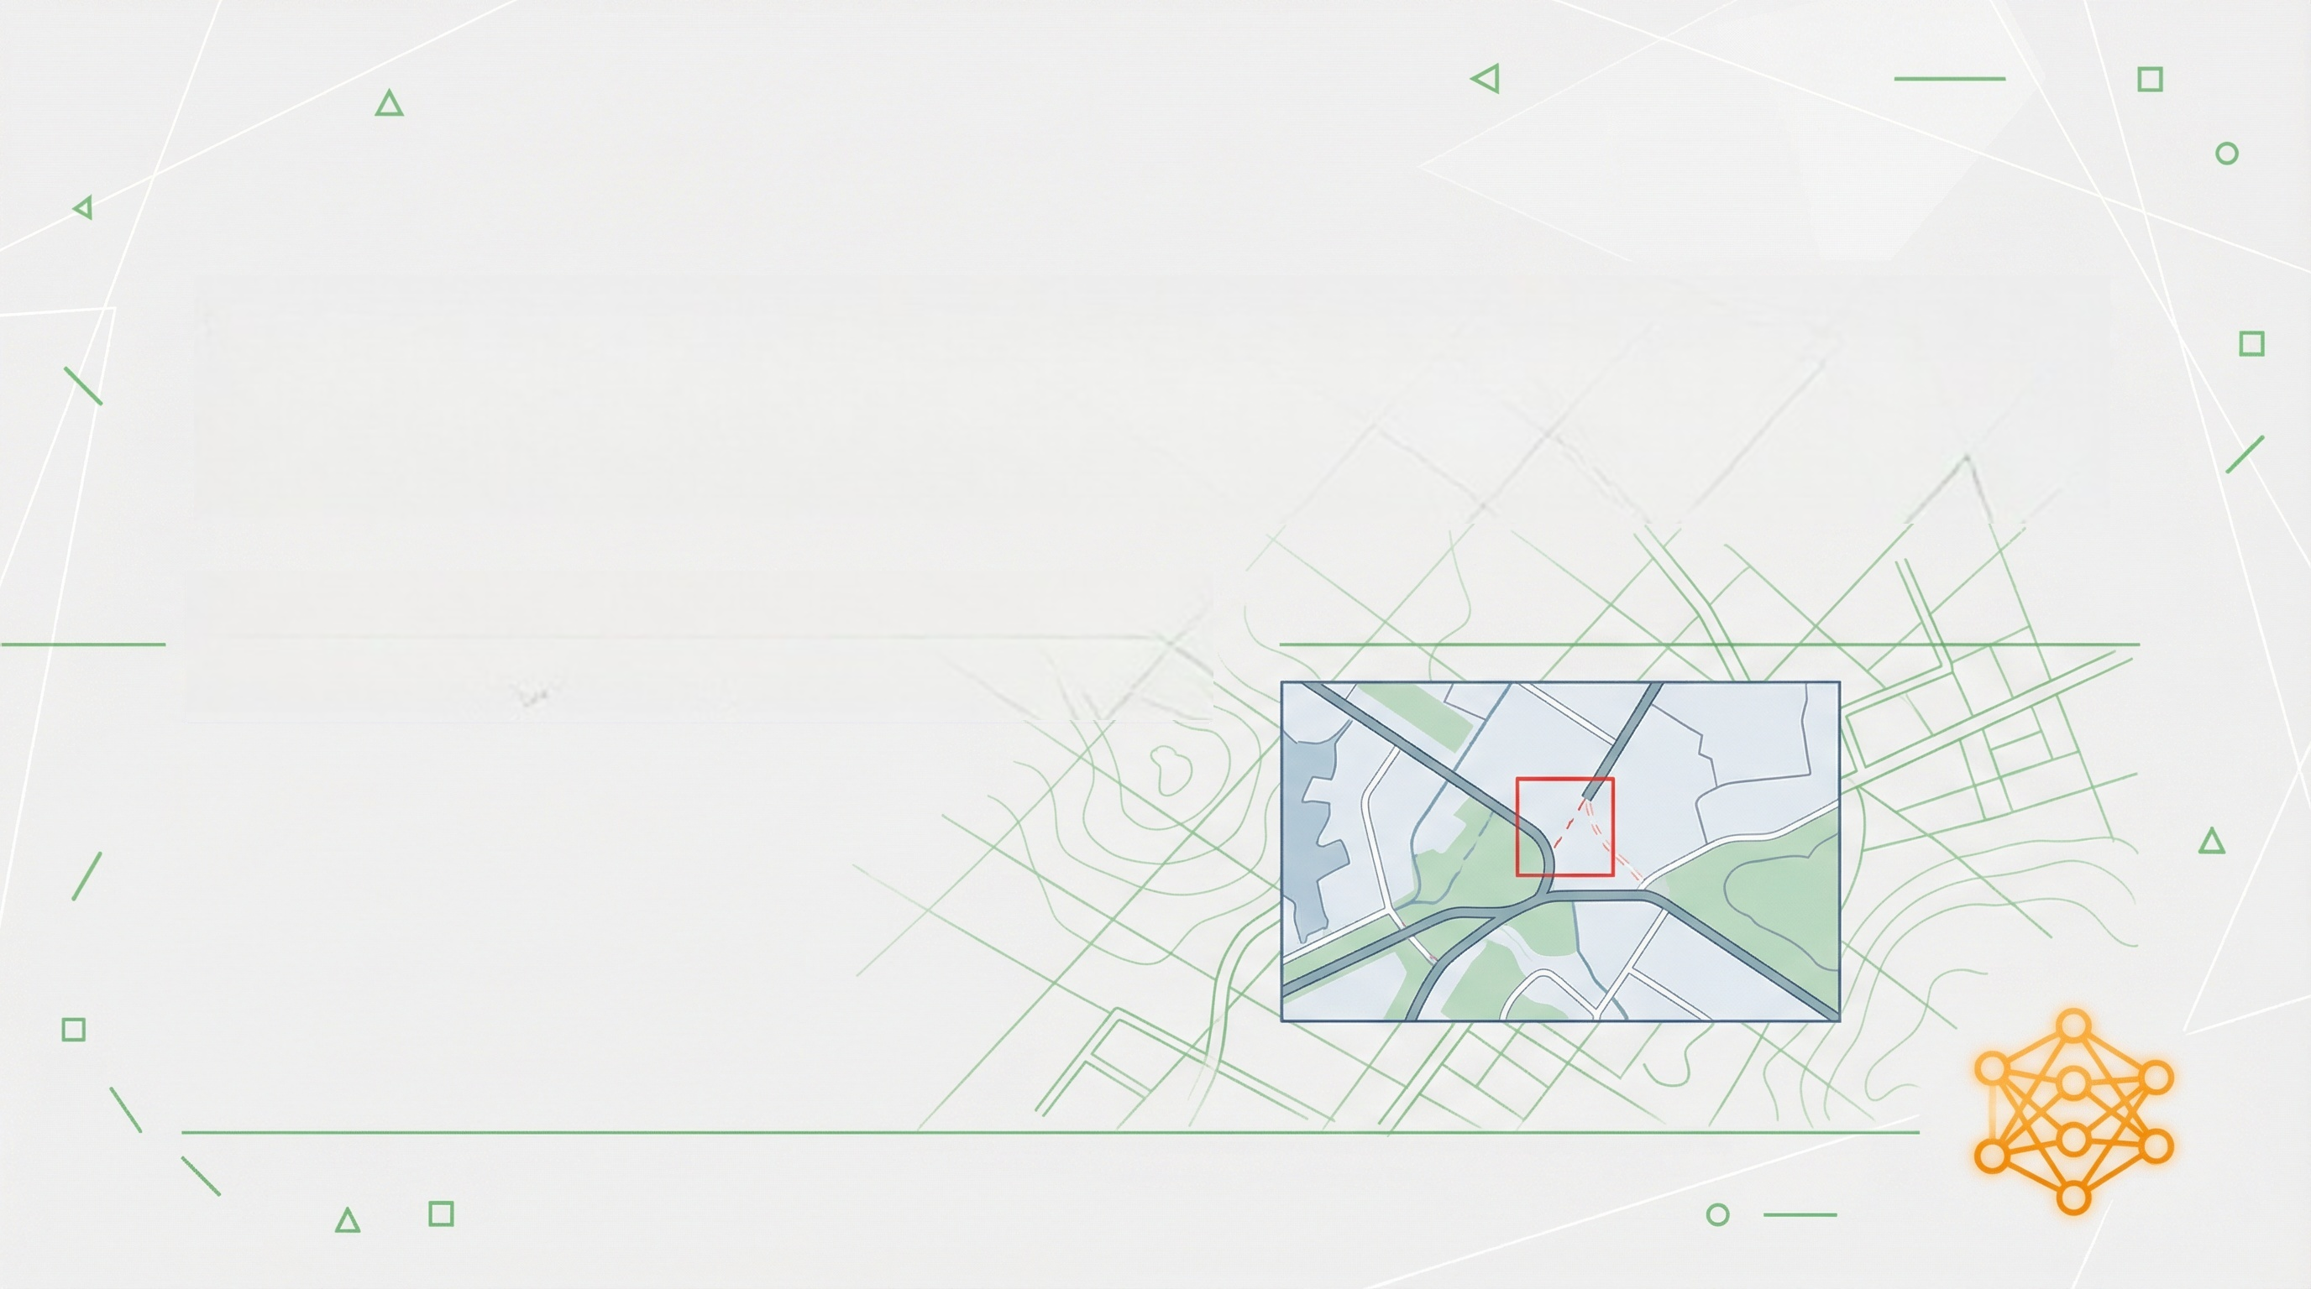
HackArena3.0
Quality Assurance Using AI: Automated Detection of Missing Line Features
Screenshot-Based Anomaly Detection for Cartographic Applications

Slide 3

HackArena3.0
Problem Understanding & Scope
Current Manual QA Challenges
Our Focused Solution
• Time-consuming visual inspection
• Target: Missing line features only
• Highly subjective and error-prone
• Method: Screenshot-based detection
• Unsuitable for scaling with data volume
• Impact: Critical map legibility issues
• Significant bottleneck in release cycles
• Approach: AI-powered visual validation
Transforming subjective visual inspection into objective, automated quality assurance

Slide 4

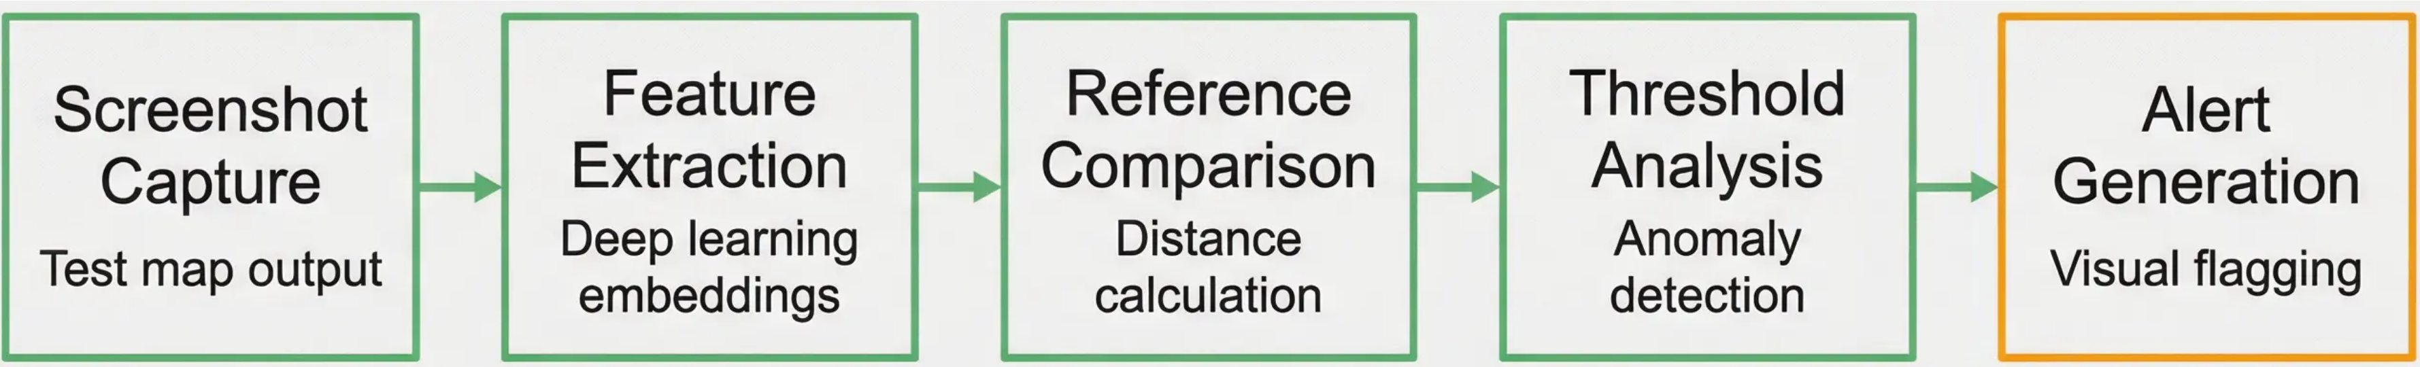
HackArena3.0
Solution Approach & Design
• Siamese neural network architecture for visual comparison • Paired dataset: correct examples vs. missing line features
Transforms subjective visual inspection into quantitative similarity measurement

Slide 5

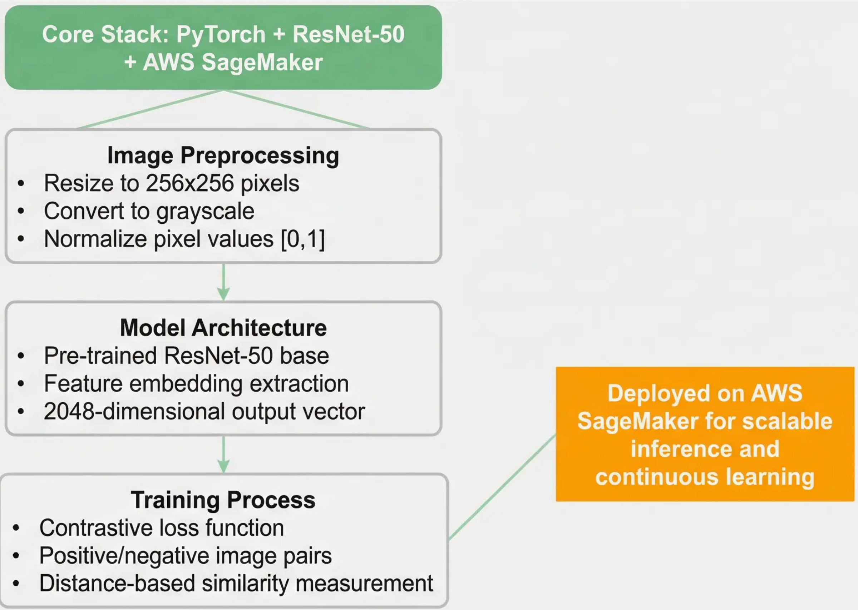
HackArena3.0
Technical Implementation

Slide 6

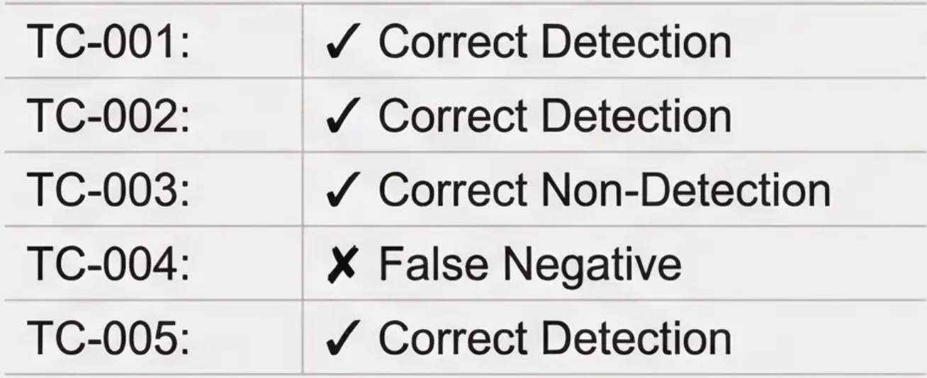
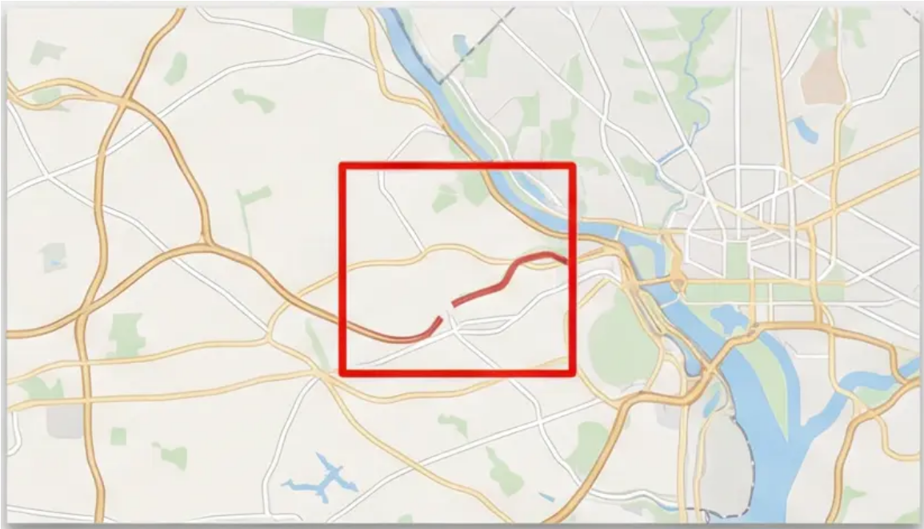
HackArena3.0
Results & Effectiveness
Detection Rate: 95% (19 out of 20 test cases)
Test Case Results Summary
False Positive Rate: <5% (1 out of 20 test cases)
System reliably identifies target errors with precise localization
Red bounding boxes accurately locate missing features for immediate review

Slide 7


HackArena3.0
Innovation & Practical Value
Key Innovation
Operational Benefits
• Paradigm shift: Manual → Automated QA • Computer vision for cartographic validation • Objective visual inspection at machine speed
• Reduces QA time by ~80% • Seamless CI/nightly build integration • Focus human expertise on flagged issues only
Scalable Quality Assurance: Consistent performance regardless of data volume

Slide 8

HackArena3.0
Limitations & Future Improvements
Current Limitations
Future Enhancements
Detects only missing line features Cannot identify styling or topological errors Challenges with complex, high-density maps Requires human validation for flagged cases
Multi-error detection capabilities Continuous learning feedback loops User-friendly web interface Enhanced accuracy for complex layouts
Expanding from specialized detection to comprehensive visual QA automation

Slide 9

HackArena3.0
Final Declaration
Mission Accomplished: AI-Powered QA System Successfully Delivered
Single Error Focus: Missing line features detection
Clear Output: Visual localization with bounding boxes
Training Complete: Validated on provided dataset
Real-World Ready: 95% detection rate on test cases
Ready for integration into cartographic software QA pipeline

Slide 10
THANK YOU
HackArena3.0

